Slide 1
Psychological Issues in Death & Dying

Slide 2
Important Note
In today’s lecture, we will discuss very important but difficult topics such as suicide, death, and terminal illness. Please treat these conversations with the respect they deserve.
A note: In following with the APA guidelines, rather than saying someone “committed suicide,” we say someone “died by suicide.” This framing highlights the underlying mental illness, rather than treating it like a crime. While this may be a new phrasing for you, please do your best to follow these guidelines in this class. (As an additional note, switching the terminology outside of this class could make a large difference to the people around you as well, even if that person never says it).

Slide 3
Agenda
Deaths Through the Ages
Legalities of Terminal Illnesses
Issues in Advancing Illness
Grief and Processing

Slide 4
Death in Childhood
Infant mortality rate – the rate of death in children under one year old
Rate in United States (5.6 deaths per 1,000 live births) is higher than in most developed countries (ex: 3.8 deaths per 1,000 live births in the UK, and 2.9 deaths per 1,000 live births in Australia)
This is linked to health care costs, with the highest mortality rates occurring in financially strained homes, with limited education and health care access
Sudden infant death syndrome – a condition where a child stops breathing during sleep. The cause is still unknown.
Causes of death: accidents, cancers (especially Leukemia), and suicide
The understanding of the concept of death develops sometime between age 5 and 9 years old, depending on the child

Slide 5
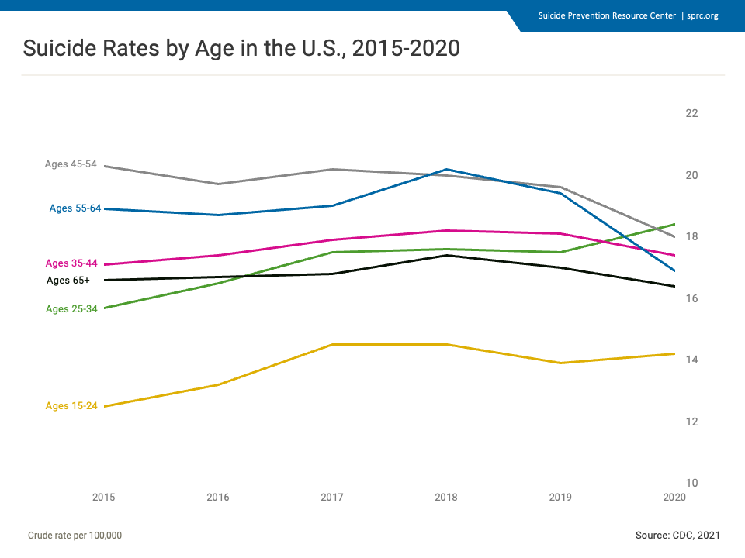

Slide 6
Death in Adolescent, Young, and Middle Adults
The leading cause of death in adolescence and young adulthood is unintentional injury (ex: car accidents)
For 15-24 year olds, the second leading cause of death is homicide, followed by suicide
For 25-34 year olds, the second leading cause of death is suicide, followed by homicide
For people in the middle ages (35 to 64 years old), the leading causes of death are unintentional injuries, cancer, and heart disease (though the order varies)
Premature death – death that occurs before the average age for the population
In the United States, the average age is 78.4 years old

Slide 7
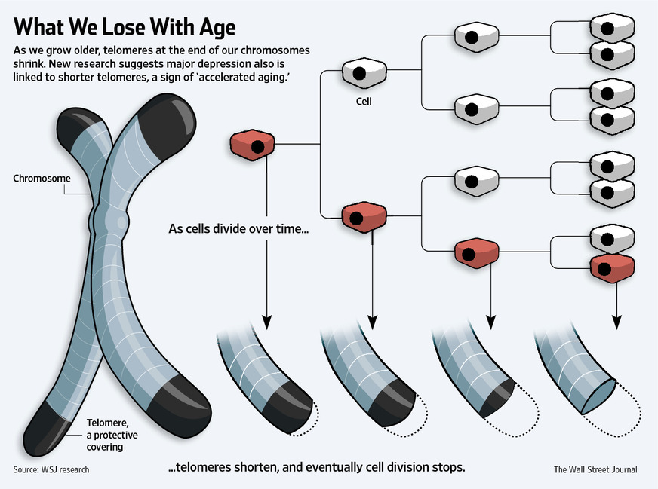

Slide 8
Death in Older Adults
Older adults most often die of degenerative diseases, such as heart disease, cancer, stroke, Alzheimer’s disease, or chronic lower respiratory disease
The terminal phase of illnesses are typically shorter for older adults, due to multiple biological competitors for death
Women typically live longer than men (average lifespan for a woman is 81 years, as opposed to 76 years)
Proposed reasons include risky behaviors, social support, and biological fitness
Lifespan is heavily impacted by health behaviors, such as diet, exercise, and substance use

Slide 9
Legalities of Terminal Illness
Advanced directive – a legal document that outlines wishes for future health care
Living will – a type of advanced directive that dictates end-of-life care instructions (can include a Do Not Resuscitate [DNR] order)
Health care proxy – an individual chosen to make health care decisions for a person once they are no longer able to decide for themselves
Power of attorney – a person elected to handle legal, financial, and medical matters once a person is incapacitated or deceased
Hospice care – end-of-life care provided by healthcare professionals; can be at home or in a facility, such as a nursing home
Home care – end-of-life care in a patient’s home; often heavily relying on a family member as a caretaker
Curative care – care designed to treat a patient’s disease
Palliative care – care designed to make a patient feel comfortable
Includes pain management, psychological guidance, and spiritual care
This form of care can be extremely difficult for hospital staff. There is a balance between emotional burnout and empathy
Death education – training on the causes and realities of death, to develop realistic expectations

Slide 10
Issues in Advancing Illness
Is there a right to die?
The 1990 Patient Self-Determination act led to the requirement that Medicare and Medicaid health care facilities allow a DNR order
Concern: These DNRs are not being followed (one study found that physicians did not follow DNR in 1/3 of their patients)
Euthanasia – the intentional act of a physician administering a lethal dose of a substance to a patient
Illegal in the United States
Physician-assisted death – when a physician provides a lethal dose of a substance to a patient, and allows them to end their own life
Legal in 11 states and D.C. (17 other states are considering)
Began in Oregon in 1997 with the Death with Dignity Act
Patient must be mentally competent, informed of alternatives, have a terminal illness with less than 6 months to live, must request this option at least three times, and must be consulted with a second physician
Patients most often reported concerns about maintaining autonomy

Slide 11
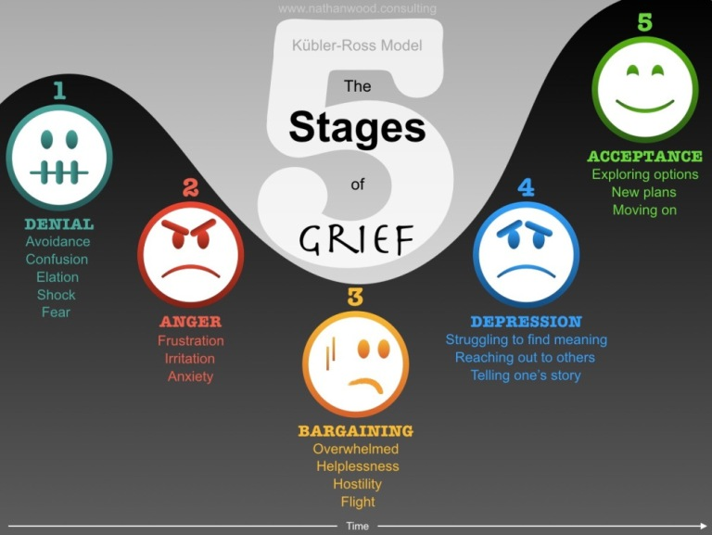
Grief and Processing
The Kubler-Ross Five-Stage Theory
The Ball-in-the-Box Analogy

Slide 12
Next Time on PSY 440…
Before Next Class:
Complete today’s journal prompt
Due 4/13 at 11:59 pm
Submit HIP
Due TONIGHT at 11:59 pm
In Our Next Class:
Class activity!
Note: This activity may be emotionally straining. If discussing death is emotionally triggering and may not be comfortable in a public setting, please speak with Dr. S BEFORE Monday

